Slide 1
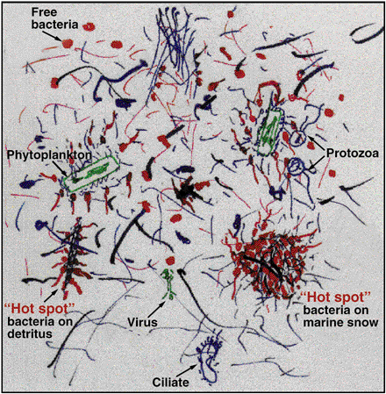
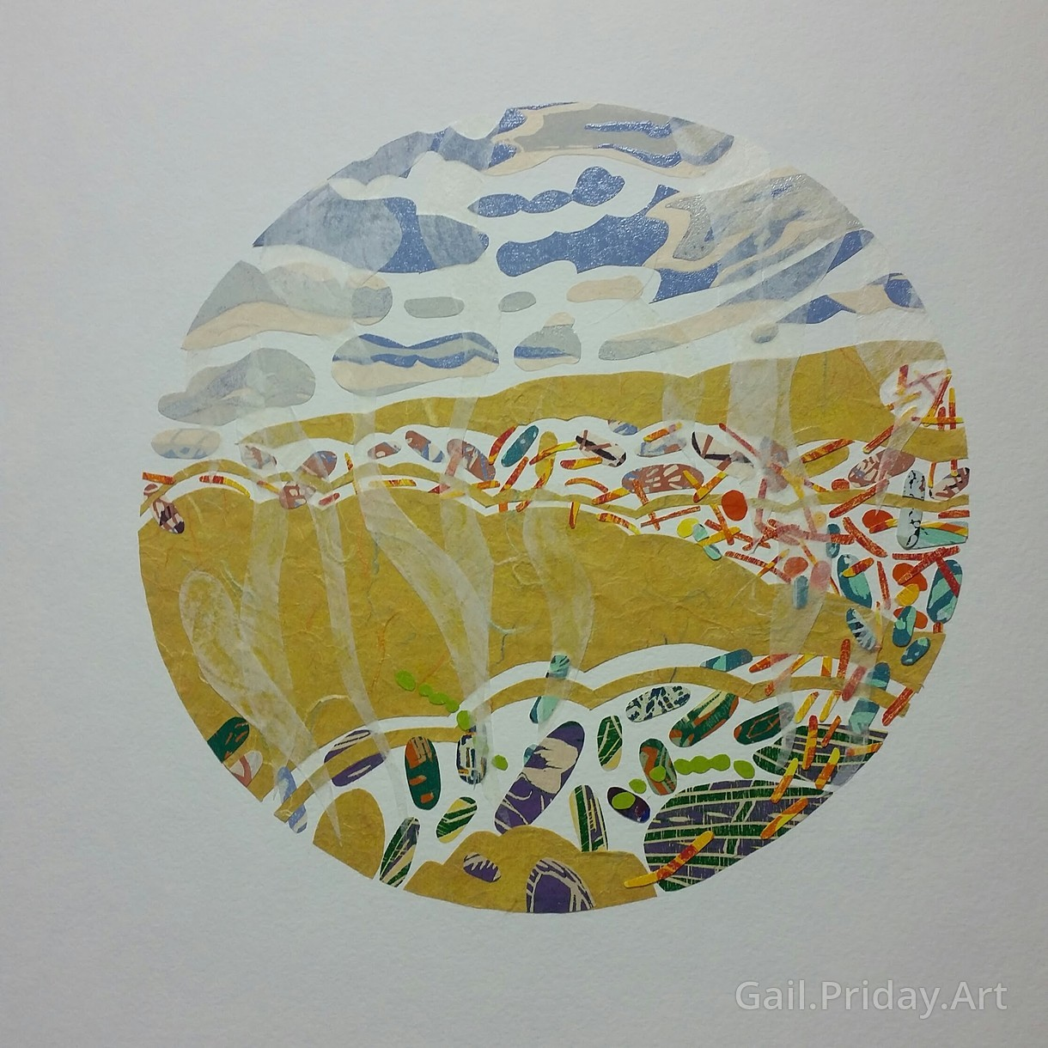
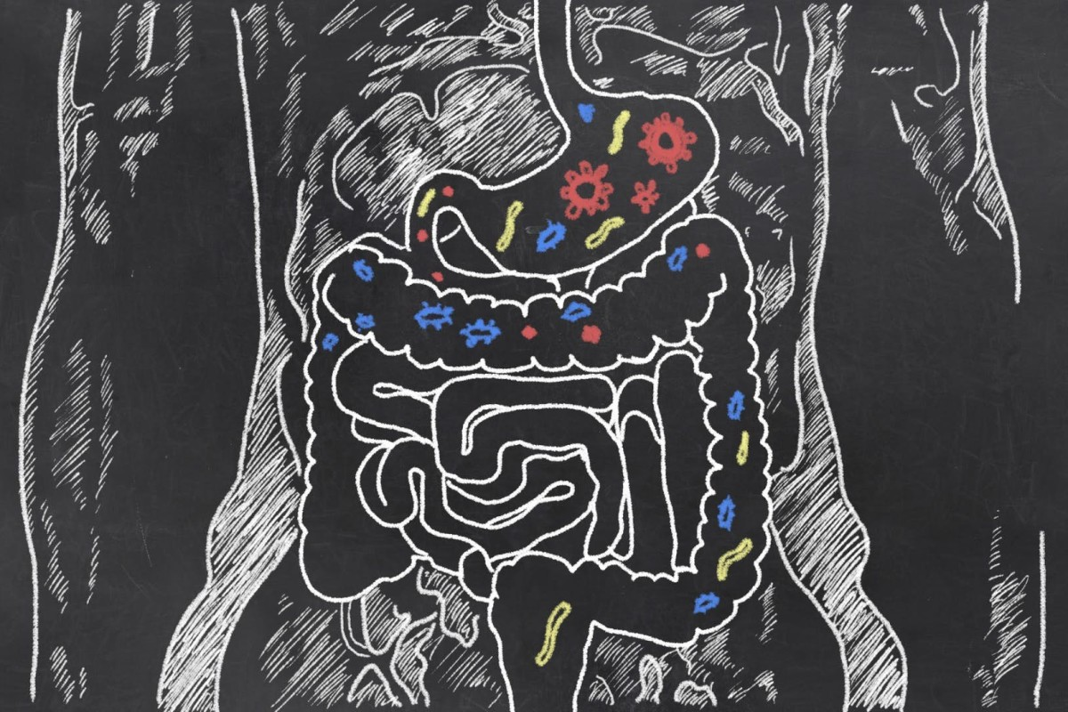
Metagenomics Lesson 4

Slide 2
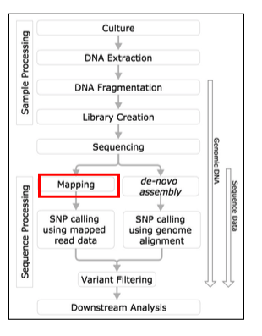
Metagenomics Lesson 3
Read mapping using bowtie2
What is read maping?
Alignment scoring
Different read mappers
Burrows-Wheeler algorithm
Demo: bowtie2

Slide 3
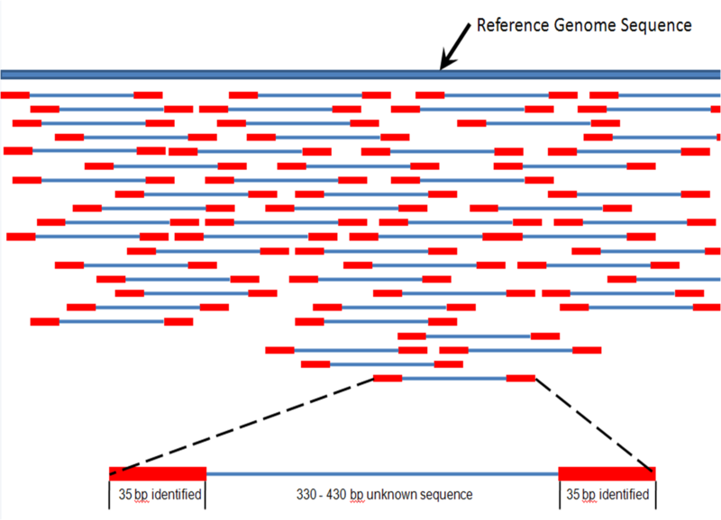
What is read mapping?
Alignment of short read to a reference genome
Find the area in the genome where the read matches best
Requires millions of string searches in a long string.

Slide 4

Why map reads?
Determine presence/absence of a genome in a sample
Calculate coverage as a measure of relative abundance
Determine variants like SNPs
Use coverage for binning of MAGs

Slide 5
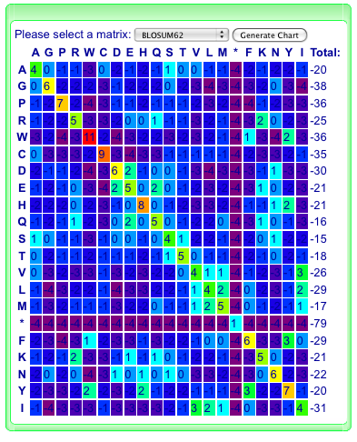
How does alignment work?
Very generally:
Find options for where a read might map using kmers
Score the sites by # matches, # mismatches and # indels
Pick the best hit
There are many scoring matrices that differ in their penalty for mismatches, gaps and gap extensions

Slide 6

Read mapping tools
BWA
Bowtie2
BBmap
Smalt
SOAP2
TopHat
And many more…
Comparison between popular mappers:
http://merenlab.org/2015/06/23/comparing-different-mapping-software/

Slide 7
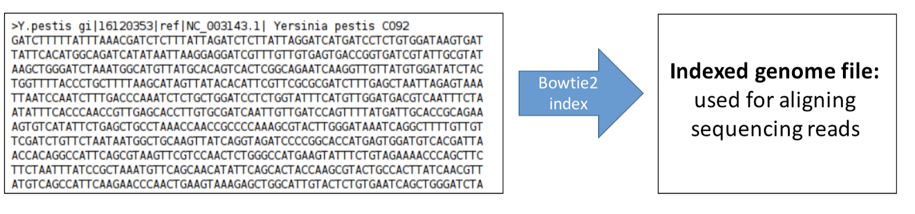
Bowtie2: Build reference genome index
Typically start with genome sequence file (in fasta format)
Burrows-Wheeler Transformation + FM index

Slide 8
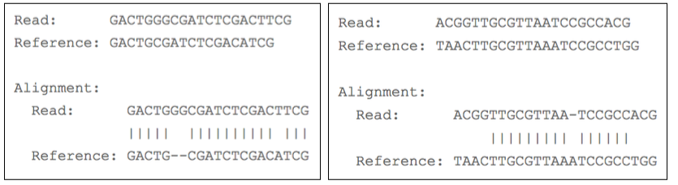
Bowtie2: Aligning sequencing reads to reference genome index: Many parameter options!
End to end alignment:
Uses all bases in read
Local alignment:
Can exclude bases at the ends of the read
http://bowtie-bio.sourceforge.net/bowtie2/manual.shtml

Slide 9
Bowtie2: Mapping quality
Sometimes it is challenging to identify the correct location in the reference genome (especially for reads that align to repetitive regions)
indels are challenging (sometimes require a secondary realignment step; other software may be better for this such as GATK)
MAPQ = Mapping quality (Q = -10 log10 p)
Where p is the probability of an incorrect alignment (the read’s true origin is somewhere else in the genome)
High MAPQ scores are better for more confident DNA variant calling

Slide 10
Bowtie2: Dealing with paired-end reads
Concordant pair: Match expectations - Orientation and spacing OK
REFERENCE GENOME
read 1
read 2
Discordant pair: Does not match expectations! Read 2 is in an insertion element that is not in this location the reference genome
INSERTION ELEMENT
read 1
read 2

Slide 11
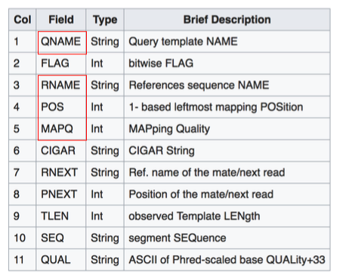
SAM/BAM files- The output of sequence alignment software (like Bowtie2)
SAM = Sequence Alignment/Map format (Text-based format)
BAM = Binary format of a SAM file. Better for computation.

Slide 12
Example SAM file
RNAME, POS,MAPQ
QNAME

Slide 13
SAMtools: Processing SAM/BAM files post alignment
• Sorting SAM/BAM reads by chromosome position – this is done prior to variant calling
• Remove duplicate reads – This is often done (as these may be PCR artifacts introduced during the prep of the sequencing library)
http://samtools.sourceforge.net/

